Slide 1
Contemporary Tourism
The Scope of the Contemporary Tourism Sector

Slide 2
Lecture Objectives
Be aware of the scale and scope of the tourism industry
Understand the difficulties of defining the tourism industry
Be aware of the various approaches to defining tourism from a supply-side perspective
Recognise that tourism is a partially-industrialised system
Recognise the issues involved in measuring the contemporary tourism industry
Understand the status of tourism in standard industrial classifications
Appreciate the tourism satellite account approach and its benefits
Be familiar with the challenges of measuring the scale of tourism employment

Slide 3
Scope of the Tourism Sector
The world’s largest industry?
The impact of COVID-19 devastating
How do we measure the sector?
Tourism challenges contemporary paradigms
Tourism is complex
We have not really got to grips with its measurement

Slide 4
Scope of the Tourism Sector
Diverse
Not a single product
Tangible and intangible elements
Produced where consumed
Misunderstood and under-explored

Slide 5
Components of the Sector
1. Tourism marketing
2. Tourist carriers
3. Tourist accommodation
4. Tourist attractions
5. Miscellaneous tourism services (e.g., taxis)
6. Tourism regulation (including government and education)

Slide 6
Definitions
Why define the sector?
Statistics
Legislation
Credibility
Traditional definitions based upon a single product and its market do not work for tourism

Slide 7
Smith versus Leiper
Smith - tourism is an industry that can be measured like any other
Leiper - tourism is a range of industries not a single one and is thus a partially industrialised system as other actors are involved

Slide 8
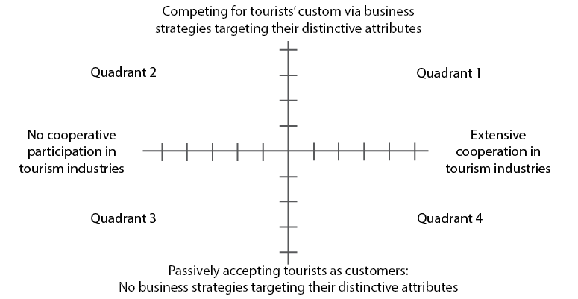
Partial Industrialisation

Slide 9
Measurement Approaches
SIC
ISIC
SICTA

Slide 10
Tourism Satellite Accounts
Developed from the mid-1990s
Breakthrough in measurement
More a demand side measure
Associate spending to tourism purchases

Slide 11
TSAs Measure:
Tourism's contribution to GDP;
Tourism's ranking compared to other economic sectors;
The number of jobs created by tourism in an economy;
The amount of tourism investment tax revenues generated by tourism industries;
Tourism consumption;
Tourism's impact on a nation's balance of payments;
Characteristics of tourism human resources; and
More recently - culture, sport and carbon

Slide 12
Use of TSAs
Provide credible data on the impact of tourism and the associated employment;
Develop a standard framework for organizing statistical data on tourism;
Set a new international standard endorsed by the UN Statistical Commission;
Design economic policies related to tourism development;
Provide data on tourism's impact on a nation's balance of payments; and
Provide information on tourism human resource characteristics.

Slide 13
TSA Issues
1. The fact that they really are a demand-side measure;
2. They are expensive to produce as they often need further data collection;
3. They are only updated infrequently and can be anything up to 8 years old;
4. They are shaped by a nation’s SIC system and so can be imprecise or a poor fit with the structure of the industry;
5. They demand powerful education of the industry to interpret them; and
6. They are dependent upon the availability, quality and quantity of data.

Slide 14
Tourism Employment
Same issues as measuring the sector as a whole
Measured by FTEs
TSAs estimate employment
Many issues relating to employment
Issue of the quality of tourism jobs - the ‘decent work’ agenda

